Slide 1


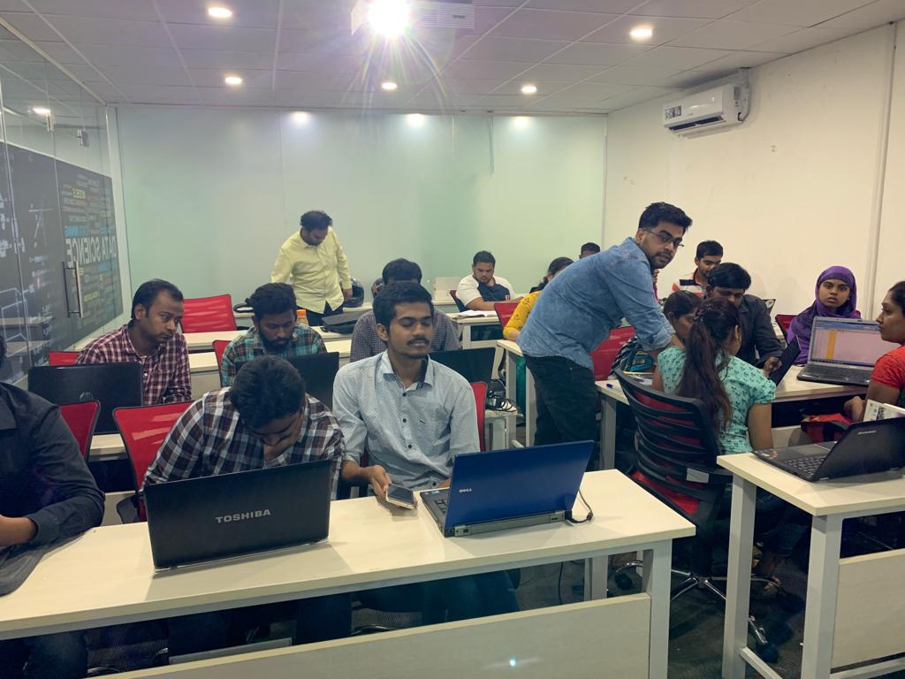





Slide 2
MUSIC RECOMMENDATION SYSTEM
GROUP 14

Slide 3
Agenda
Basic Steps involved in Building the recommendation System.
Popularity Based Recommendation System Implementation.
Collaborative Filtering Based Recommendation System Implementation
Content Based Recommendation System Implementation
Future scope of improvements.

Slide 4


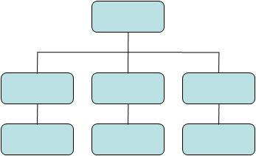

BASIC STEPS PERFORMED TO BUILD A RECOMMENDATION SYSTEM
Importing all the necessary Libraries.
Reading the Data
Performing Exploring Data analysis.
Sorting according to characteristics of Different Genres.
Clustering Genres with K-Means
Visualizing the Genre Clusters.
Building a Content-Based Recommender System:
Based on the analysis and visualizations in the previous section, it’s clear that similar genres tend to have data points that are located close to each other while similar types of songs are also clustered together.
Building a collaborative based model:
is a method of making automatic predictions about the interests of a user by collecting preferences or taste information from many users .
Building a popularity Based Model system:
works with the trend. It basically uses the items which are in trend right now.
Analyzing the overall model build to ensure the working of recommendation System.
Analysis of Dataset
Implementation of popularity based Model
Implementation of content Based model
Implementation of collaborative model

Slide 5
Comparison Between Model Implementation
Content Based Model
Collaborative Based Model
Popularity Based model
01
02
03
Content-based filtering, makes recommendations based on user preferences for product features.
Usually it constructs and then compare user-profile and item-profile using the content of shared attribute space. For example, for a movie, you represent it with the movie stars in it and the genres.
The user’s preferences is built by analyzing the attributes of his/her previously rated items
This user profile is then used to predict the user’s interest in items by matching attributes in the
user profile with the items’ attributes
Collaborative filtering mimics user-to-user recommendations. It predicts users preferences as a linear, weighted combination of other user preferences.
They exploit behavior of other users and items in terms of transaction history, ratings, selection and purchase information. Other users behavior and preferences over the items are used to recommend items to the new users.
A typical collaborative filtering
Recommender system has a list of m users and n items, generating a user-item rating matrix “R”
to represent users’ preferences of items based on ratings obtained implicitly or explicitly
Implementing popularity-based strategy in recommender systems is a common solution for the
user cold start problem .
About the interests and
preferences of a new user or visitor in the system, the system can predict items that suit the
user’s interest by recommending popular items to users
The Popularity based recommender provide a general chart of recommended movies to all the users. They are not sensitive to the interests and tastes of a particular user
Notes:
© Copyright PresentationGO.com – The free PowerPoint template library

Slide 6
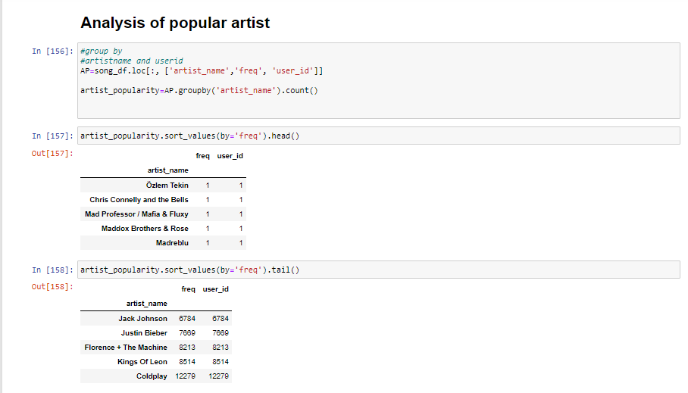
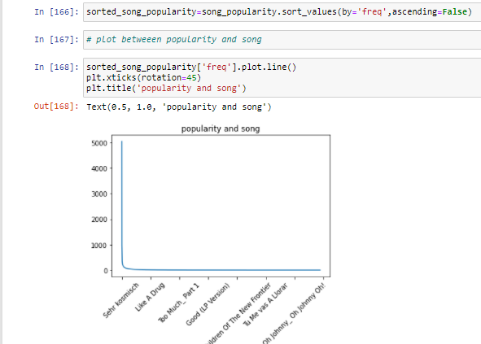
ILLUSTRATIONS
Popularity based model
The Popularity based recommender provide a general chart of recommended movies to all the users. They are not sensitive to the interests and tastes of a particular user
Analysis of popular artists has been made and have been sorted according to their popularity
This plot explains the popularity of the artist and the song.
The recommendation System works on the artist_name and the popularity of the song at present.

Slide 7
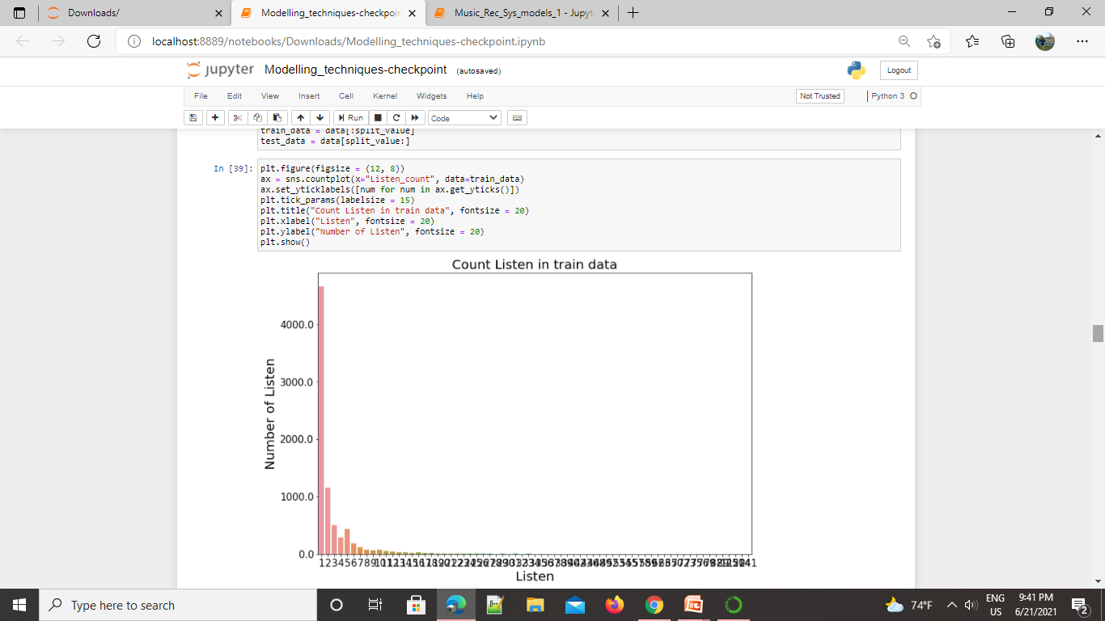
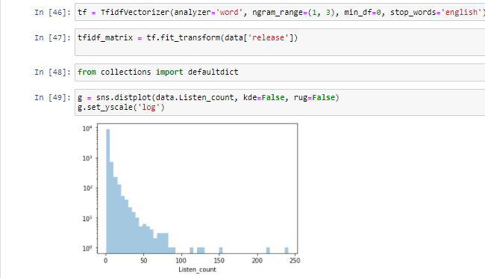
In this Case, Popularity based model is being implemented.
Insights:
Songs are being grouped based on the song_id of each song to obtain listen_count and percentage for the same.
A plot is done to implement the number of listeners and listen_count in order to train the data.
simple popularity based recommender system
In recommendation system context the decomposition happens from massive user-item matrix(sometimes called rating matrix) to individual user and item matrix.
Insights:
1. This graph Gives an insight of number of listeners per song based on Listen_count

Slide 8
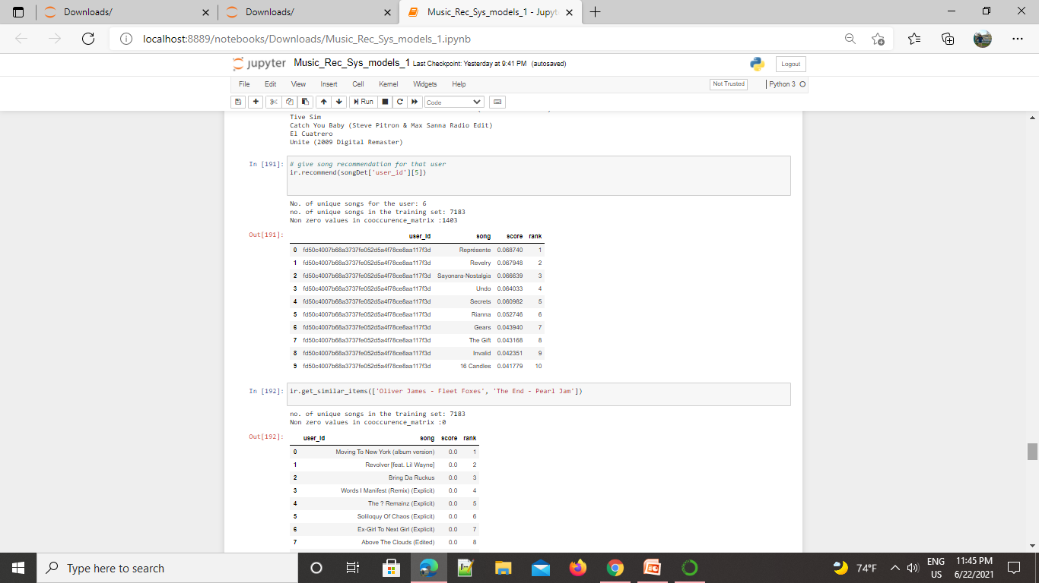
COLLABORATIVE/Item based model
Based on the item based recommendation model
We can determine
Item similarity based on the user_item it will display the songs
It is said that the No. of unique songs for the user: 6
no. of unique songs in the training set: 7183
Non zero values in concurence_matrix :1403.
When taken an analysis of ‘Oliver James’ and the ‘end pearl’
no. of unique songs in the training set: 7183
Non zero values in concurence_matrix :0

Slide 9
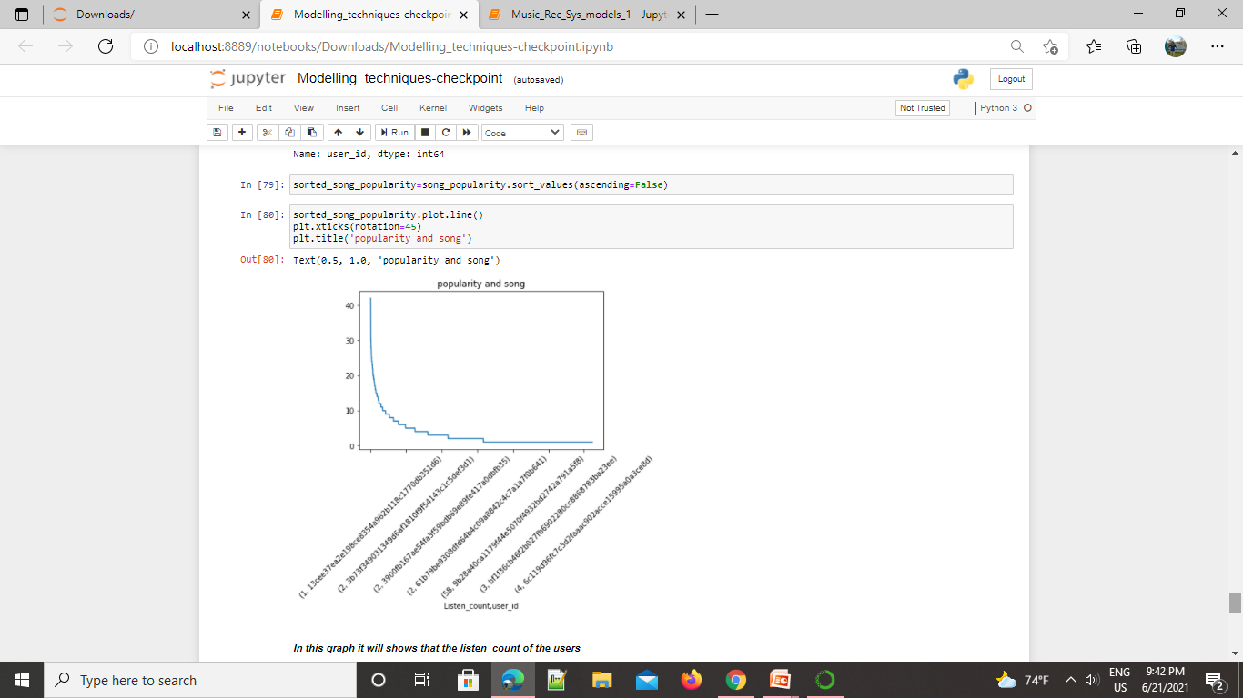
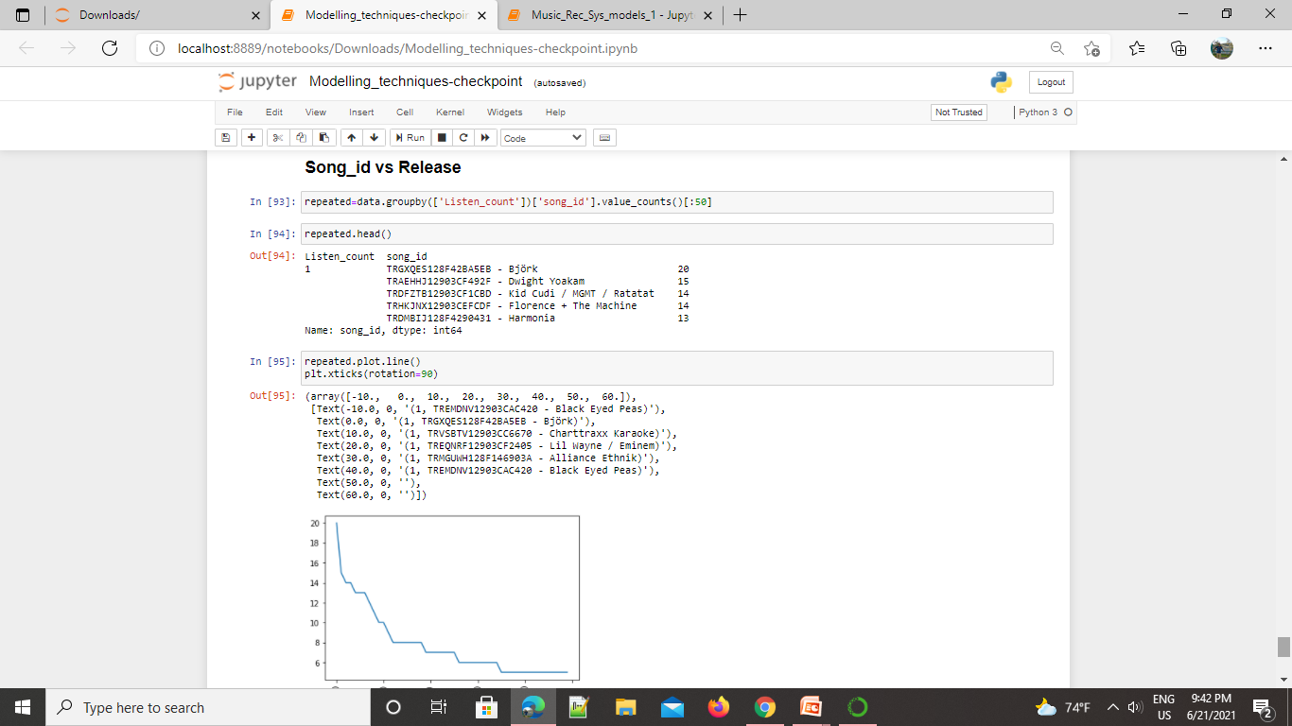
CONTENT based model
This is a plot based on the Listen _count VS user_id.
INSIGHTS:
Songs are sorted in ascending order based on the popularity of the songs and the content which is similar and mostly listened by the user.
This is a plot based on the Song_id VS Release
INSIGHTS:
This graph is shows that the Listen_counts of a songs which is the highest at Bjork but as going to the Black eyed peas it's decrease at the lowest listen_counts

Slide 10
FUTURE SCOPE OF IMPROVEMENT
Recommender systems are designed to identify the items that a user will like or find useful based on the user’s prior preferences and activities.
Deep learning has had little impact — state-of-the-art is embeddings — so far, but it holds great promise.
Currently the industry is trying to integrate various advanced recommender systems which work on group recommendations or POI (point of interest) or meta data analysis.
Content-based filtering outperforms user collaborative filtering. Items are more similar and make more sense than users similarities.
Good thing about content based approach that you don’t need data about other users in order to make recommendations.
Problem with collaborative filtering is that when a unique user has a unique taste, there might not be similar matches of other users.
Meanwhile, the content based approach can be build based on user and item profiles. Items can be recommended based on previous choices.
The best approach would be to use a combination of different approaches. Mix of collaborative and content based filtering. Some of it will depend on preferences of the users and some on item features.
The future of recommender systems lie in integrating self actualization to do justice to serendipity while recommending which will also support rather than replace human decision-making by understanding preferences.

Slide 11

ABOUT US:
J Samrat Varun : Pursuing B.Tech in Electronics Engineering from IIT Dhanbad, incoming final year student
Sahana Hegde: Pursuing B.E in Information Science and Engineering from BNM Institute of Technology, Bangalore.
Saurabh Mishra : Pursing B.tech in Electronic and communication 3rd year, From lingaya's Vidyapeeth Faridabad.
Satyam Dubey: Pursuing B.Tech in Computer Science Engineering from Global Academy of Technology, Bangalore, currently in 3rd year
5. Abhisekh Sharma: pursuing engineering in Electronic and Communication from Meerut Institute of Engineering and Technology.
THANKYOU!

